Slide 1

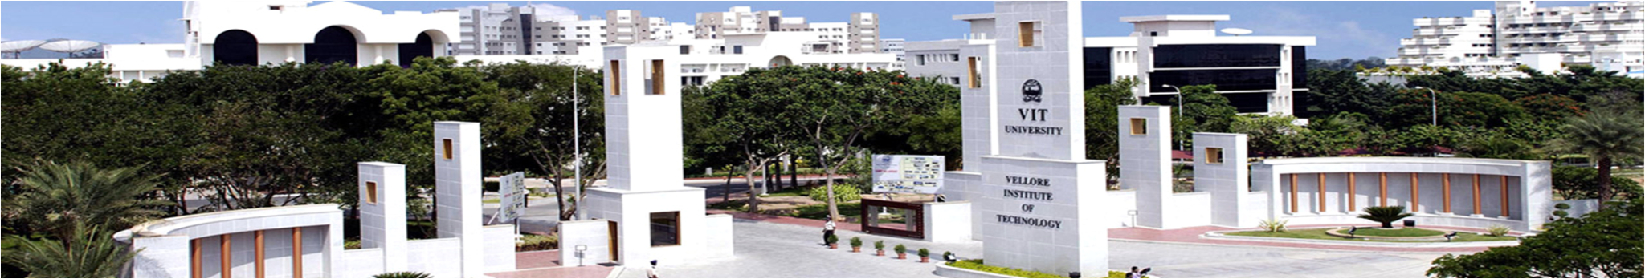
REVIEW-1
Ranganathan S V - 18BME0374
Sridharan A P - 18BME0510
Winter 2021 - 2022: Capstone Project Presentation
Reviewer 1 : Prof. Suraj Kushe Shekhar
Reviewer 2 : Prof. Vincent Herald Wilson
Prof. Ponnambalam S G
Project Guide
School of Mechanical Engineering
14-02-2022

Slide 2

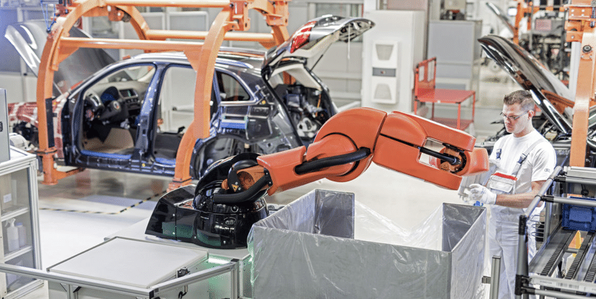
Efficient Application of Metaheuristic Algorithms for Balancing Human Robot Collaborative Assembly Lines

Slide 3

INTRODUCTION
PROBLEM DEFINITION
LITERATURE REVIEW
LITERATURE GAP
WORK CARRIED OUT SO FAR
METHODOLOGY
RESULTS
GOALS FOR NEXT REVIEW
MILESTONES
REFERENCES

Slide 4

1.INTRODUCTION
1.1. ASSEMBLY LINE BALANCING
1.2. ROBOTIC ASSEMBLY LINE BALANCING PROBLEM
1.3. HUMAN ROBOT COLLABORATION IN ASSEMBLY LINE BALANCING

Slide 5
ASSEMBLY LINE BALANCING
Assembly line in manufacturing process comes at last which delivers the finished product with sequence of several tasks. Normally these tasks were performed by humans earlier before the introduction of robots.
However, due to ever-changing consumer tastes and to outperform the competitors, many industries started using robots in their assembly line. The main reasons for this change is to improve production rate, efficiency, reduce cost(wastes) and to increase agility towards changing demands.
This use of robots in assembly line was called as robotic assembly lines(RAL). Use of robots in industries helped them to reduce labour cost, variability in production, and enhance productivity as robots can work 24/7 all year with no fatigue or illness.
Advancements in technology helped this evolution to further replace humans by robots in performing complex tasks too. Since the introduction of robots in assembly line, robotic assembly line balancing(RALB), and extension of ALB got into interest for many researchers and industries to further optimize their production.
This varied from the conventional ALBP as here two different problems are to be addressed and they are, assignment of task to the given workstations and assignment of different available robots to the workstations.

Slide 6
ROBOTIC ASSEMBLY LINE BALANCING PROBLEM
The general assembly line balancing problem has some objective such as minimising cycle time, cost, etc.., with some constraints such as precedence relation of tasks, number of workstations, etc.., As the robots are accurate in performing tasks, their task times are assumed to be deterministic while solving RAL BP. Some other assumptions made by the researchers on solving them were,
The precedence relation of tasks are known and the task times depend completely on the type of robot chosen.
One workstation comprises only one robot and all types of robot are always ready to use without any capacity and cost limitations.
Further RALBP is classified into several types such as,
RALBP TYPE I – Aims at reducing number of workstations by assigning best suited robots and tasks to workstations.
RALBP TYPE II – Aims at minimising cycle time with predefined number of workstations.
RALBP TYPE E – Aims at reducing both cycle time and workstations thus maximising the assembly line efficiency.
RALBP TYPE F – Aims at finding feasible solutions for a predefined set of workstations and cycle times.
RAL BP TYPE COST – Aims at monetary and economic aspects of RAL.
RAL BP TYPE O – Other categories are classified in this type.
In RALB, the classifications are based on the structure of the assembly lines[AL - assembly line]. They are MAL(multi manned), PWAL(parallel workstation), PAL(parallel), UAL(U-shaped), StAL(straight line), 2SAL(two sided), PUL(parallel U-line), PAUL(parallel adjacent U-line), PMAL(parallel multi-manned).

Slide 7
HUMAN ROBOT COLLABORATION IN ASSEMBLY LINE BALANCING
As the automation in manufacturing department is increasing significantly, several robots are developed to carry out several tasks to increase the production rate. However, not all tasks can be automated due to the lack of flexibility with available robotic technologies.
Humans on the other hand are flexible, adaptable according to market demands, and also have decision making skills with creativity.
To remain relevant, many manufacturing enterprises show interest in human robot collaboration where the skills of human and the speed, endurance, and accuracy of robots are brought together to increase production. This also helps the human workers as the repetitive and stressful tasks are done by robots.
Many algorithms and meta-heuristics were used to find the best allocation of robots and humans to workstations, determine the optimal task sequence, cycle time, etc.., Some are,
Artificial Bee Colony Algorithm (ABC)
Genetic Algorithm (GA)
Differential Evolution (DE)
Teaching Learning based optimization (TLBO)
Particle swarm optimization (PSO), etc..,

Slide 8
2. PROBLEM DEFINITION

Slide 9
PROBLEM DEFINITION
The project aims to balance and improve the efficiency of different assembly line tasks that involves collaborative robots working hand in hand with humans. This is to be done through development of optimization algorithms by varying current metaheuristic algorithms, with an intention of less complex data processing and increased efficiency.
PROBLEM STATEMENT:
To develop metaheuristic algorithms for balancing and scheduling of assembly line operations.
Considered assembly line structure = StAL (straight line assembly line).
Only one product is assembled in the assembly line with known number of workstations.
Considering setup times and sequence dependent time.
This problem type is classified as multi objective RAL BP TYPE - II that focuses on minimising cycle time and energy consumption with given number of workstations.
The two algorithms that we focus on modifying (make some changes to fit our problem statement) are,
Particle swarm optimisation (PSO)
Teaching learning based optimisation (TLBO)

Slide 10
PROBLEM DEFINITION
WHY PSO and TLBO a GREAT CHOICE TO OUR PROBLEM:
The problem that we considered is solving multi objective human robot collaborative assembly line balancing.
TLBO being a new algorithm, is yet to be explored by many researchers and this gives novelty to our paper.
TLBO and PSO can be modified easily according to the problem as it has very less parameters yet more combinations that influences the output.
Many new variants can be created from TLBO and PSO as the concept is simple and easy to implement.
TLBO and PSO can be merged with other popular meta-heuristics such as Differential evolution, Genetic algorithm, etc.., and a hybrid algorithm can be created, which uses the simplicity of TLBO and PSO with the marginal advantages of other popular algorithms.

Slide 11
3.LITERATURE REVIEW
3.1. ALB & RALB
3.2. RALB WITH HUMAN COLLABORATION
3.3. SOME POPULAR META HEURISTIC ALGORITHMS INVOLVING PSO & TLBO

Slide 12
Title of the paper | Journal & Year | Authors | Description/ Remarks
A comprehensive review of robotic assembly line balancing problem. | Journal of Intelligent Manufacturing, 2020 | Parames Chutima | Paper contains all types of RALB problem approaches till date including classifications, solution methods, layout considerations.
Assembly Line Balancing with Collaborative Robots under consideration of Ergonomics: a cost-oriented approach | IFAC PapersOnLine 52-13 (2019) | Christian Weekenborg, Thomas S. Spegler | Robot ergonomic considerations like task suitability and precision factors, working environment and runtime, orientation in workstations were referred for our objective problem.
Balancing of assembly lines with collaborative robots. | Business Research, 2019 | Christian Weckenborg, Karsten Kieckhafer, Christoph Muller, Martin Grunewald, Thomas S. Spengler | RALB problem solution approaches and considerations that weren’t accounted for previously.

Slide 13
Title of the paper | Journal & Year | Authors | Description/ Remarks
Assembly line balancing: What happened in the last fifteen years? | European journal of operational research, 2021 | Nils Boysen, Philipp Schulze, Armin Scholl. | Puts forth every type of assembly line problem solution approaches and work considerations. Every algorithms used till date and their suitabilities are given.
An analysis of task assignment and cycle times when robots are added to human-operated assembly lines, using mathematical programming models. | International journal of production economics, 2021 | Tamas ´ Koltai, Imre Dim´eny, Viola Gallina, Alexander Gaal, Chiara Sepe. | Puts forth three different layouts for human-robot assembly line (only human/both in a workstation/both in different workstations). An MILP approach to solve every scenario was formulated, which was referred for our problem synthesis.
Identification and classification of risk factors for human-robot collaboration from a system-wide perspective. | Computers and industrial engineering, 2022. | Nicole Berx, Wilm Decre, Ido Morag, Peter Chemweno, Liliane Pintelon. | Tabulates all possible risks in a human-robot collaborative assembly line environment, along with precedence insights of every risk. Risks are referred to effectively formulate our problem in objective of increasing ergonomics.

Slide 14
Title of the paper | Journal & Year | Authors | Description/ Remarks
A Multi-Objective Particle Swarm Optimization Algorithm Based on Gaussian Mutation and an Improved Learning Strategy. | Mathematics, 2019 | Ying Sun, Yuelin Gao. | Introduction of new gaussian mutation throw point strategy to memorize all the non-dominated solutions (pareto optimal solutions in the population); Various other related strategies.
Multi-objective discrete particle swarm optimisation algorithm for integrated assembly sequence planning and assembly line balancing. | Journal of engineering manufacture, 2016 | Ab Rashid, M. F. F., Hutabarat, W., & Tiwari, A. | Insights on commands for every arithmetic operations involved in PSO equations. Was used to gain an understanding to deal with problems that needs to maintain the population members’ values within context.
Multi-objective particle swarm optimization approaches. | In book: Multi-objective Optimization in Computational Intelligence: Theory and Practice, 2008 | Parsopoulos, Konstantinos & Vrahatis, Michael. | Variant models of IPSO with three non-linear time-varying strategy introduction; MPSO with asymmetric time varying trend for acceleration coefficient adjustment. Both for biasing pace of coefficient c.

Slide 15
Title of the paper | Journal & Year | Authors | Description/ Remarks
Particle Swarm Optimization Variants for Solving Geotechnical Problems: Review and Comparative Analysis. | Archives of Computational Methods in Engineering, 2021 | Ali R. Kashani, Raymond Chiong, Seyedali Mirjalili & Amir H. Gandomi | Review of variants like Comprehensive learning PSO (CPSO), Extraordinary PSO (EPSO), Heterogeneous comprehensive learning PSO (HCPSO), Darwinian PSO (DPSO), fractional-order DPSO (FDPSO), improved random drift PSO (IRDPSO) algorithms.
A modified teaching-learning-based optimization algorithm for solving optimization problem. | Knowledge-Based Systems (2020) | Y. Ma, X. Zhang, J. Song et al. | Variant mTLBO, introduced concept of tutorial class in the Learner Phase and its implementation. DLTLBO, where a neighborhood search of teacher phase is added to produce a new mutation vector, thereby taking advantage of differential learning (hybrid).
An efficient Balanced Teaching-Learning-Based optimization algorithm with Individual restarting strategy for solving global optimization problems. | Information Sciences, 2021 | Ahmad Taheri, Keyvan RahimiZadeh, Ravipudi Venkata Rao. | Balanced TLBO (BTLBO), introduced two new phases; tutoring and restarting phase, providing a balance between exploitation and exploration capabilities. Emphasis on increasing the possibility in finding the global optima.

Slide 16
Title of the paper | Journal & Year | Authors | Description/ Remarks
Balancing of mixed-model two-sided assembly lines using teaching-learning based optimization algorithm. | Pamukkale University Journal of Engineering Sciences, 2018 | Hamzadayi, A. | Task allocation algorithm using TLBO for a real time two-sided assembly line model. Referred for mixed model approach used while line balancing.
An Improved TLBO Algorithm for Balancing Stochastic Two-Sided Assembly Line. | Applied Mechanics and Materials, 2014 | Li, Da & Zhang, Chaoyong & Shao, Xin & Xie, Zhan. | Referred as an additional material for validating the fact of non TLBO usage in robotic assembly lines.
Balancing stochastic two-sided assembly line with multiple constraints using hybrid teaching-learning-based optimization algorithm. | Computers and Operations Research, 2017 | Qiuhua Tang, Zixiang Li, LiPing Zhang, and Chaoyong Zhang. | Basic approach in using TLBO to solve two-sided assembly line balancing problem. Referred the constraints considered for two/one side distinguishment.

Slide 17
4. LITERATURE GAP

Slide 18
LITERATURE GAP
Since the study started on RAL BP, only 33 articles were published till date since 1991(over 30 years). The research on this field was less and skyrocketed recently (2015-2019).
Since 1997, most of the researchers started using deterministic variable task times that were determined on the types of robots. This was due to the development in technology that resulted in invention of many different robots that can perform all the tasks.
Mathematical models were used to describe the relations between the different objectives and to handle the constraints effectively. As the size of the problem increased, meta-heuristics started dominating the other methods. Many meta-heuristics were developed to tackle this NP-hardness of the RALBP.
Introduction of Cobots(collaborative robots) to the assembly line, created a new trend in the research area of RALBP. This use of cobots in the assembly line showed better results and gained interest by many industries. As this area of research is quite new, only few papers were published since 2019.
Many real life constraints such as tools assignment, tool space optimization, etc.., were not addressed in most of the papers and this could be the future in the study of RAL BP.

Slide 19
LITERATURE GAP
Almost all the research on RALBP assume fully automated assembly line which requires huge investments. Not all the industries are capable to do such investments and still many of the industries slowly started to introduce robots in their assembly lines. So the study on human robot collaboration assembly line could be a great research area as many industries opt them as they are easy and require less investment.
The studies that included cobots in the assembly line mostly preferred only one robot in a workstation. Research study on multiple robots and humans working in parallel could be a great area of research. As humans started working alongside robots, study of ergonomics and real life constraints such as human fatigue, sequence dependent setup times, tool and accessory changing, part transportation between stations, etc.., can be included in RABLP as no one has ever did that previously due to its high complexity.
Most industries focus on only one objectives while designing assembly lines rather than many. Research on Multi objective optimizations could be more relevant to real life problems. As introduction of multi objectives create more complexity, many meta-heuristics were developed. From the recent studies, hybrid metaheuristics showed better results than meta heuristics. So study on hybrid metaheuristics on solving multiple objectives could create a way for finding better pareto optimal solution sets.

Slide 20
5.WORK CARRIED OUT SO FAR
5.1. SEQUENCE GENERATION
5.2. OBJECTIVE FUNCTION EVALUATION (cycle time)
5.3. FORMULATING THE ALGORITHMS (PSO & TLBO)

Slide 21
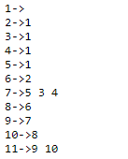
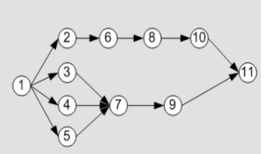
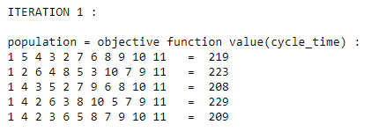
SEQUENCE GENERATION
For generating sequence, a precedence matrix is generally used in many papers.
But in our proposed method, we use adjacency list that stores the precedence relation efficiently and helps in generation of sequence that satisfied these relations.
The algorithm is as:
First a available set is created with the tasks that has no precedence tasks.
Then one task is selected randomly from that set and the tasks following it are added in the available set.
This step is repeated until all the tasks are assigned and available set is empty.
The use of adjacency list is very helpful in implementing this algorithm.
Adjacency holds the data as shown in this example.

Slide 22
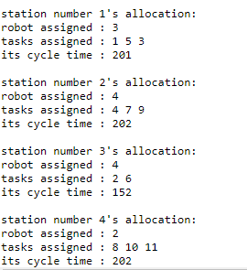
OBJECTIVE FUNCTION EVALUATION (cycle time)
For calculating the cycle time of a particular sequence generated, consecutive method algorithm is used. The working of this algorithm is:
Cycle time is initially fixed with a value by summing up the minimum task time of all robots.
For each station, the sequence is tried with all the available robots with given number of stations and the cycle time that is found previously.
In each iteration, if the found cycle time is not feasible, the cycle time is incremented.
This step is repeated until a feasible cycle time is found which is the optimal cycle time for the given sequence.
For example, the image on the right shows an example of allocation of tasks in each workstation using the consecutive method.
As we can see here, the overall cycle time of such allocation is maximum cycle time, i.e.., 202 for the sequence [1, 5, 3, 4, 7, 9, 2, 6, 8, 10, 11]

Slide 23
FORMULATING THE ALGORITHMS
For implementing the standard PSO & TLBO for a discrete problem, some assumptions and formulations are made such as,
Population matrix consists of feasible sequences.
Velocity matrix consists of randomly generated numbers ranging from [0 - no_of_tasks].
A new counter array is used that stores an integer that indicates the number of times the solution is retained in the population.
A new best_solution (variable) is used to keep track of the best solution removed from the population in the last phase of the algorithm.
Updation of the swarm is done according to the rules that is mentioned in upcoming slides.
For encoding purpose, only the sequence array is used.
For decoding purpose, the robots assigned and the tasks performed in each station is determined by knowing the optimal cycle time.
The addition of setup times and sequence dependent time is used to make the problem more suitable for industrial purposes.
Setup time is added with the task time for each task performed by the robot.
Sequence dependent time is added only for the tasks that are not first in the station as these times are dependent on the previously performed tasks(first performed task in each station by the robot has no previous task).

Slide 24
6.METHODOLOGY
6.1. WORKING OF TRADITIONAL PSO
6.2. WORKING OF MODIFIED DPSO
6.3. WORKING OF TRADITIONAL TLBO
6.4. WORKING OF HYBRID TLBO

Slide 25
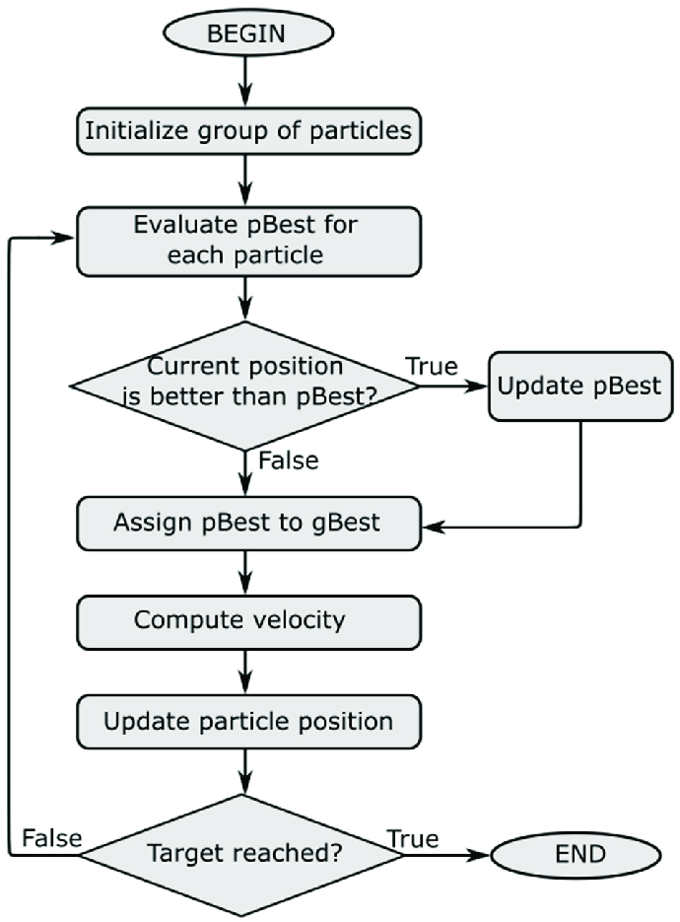
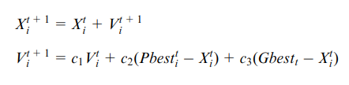
WORKING OF TRADITIONAL PSO
NOTATIONS USED:
t = indicates the iteration number
Xi = a single i’th solution in the population
Vi = a single i’th velocity vector in the population
P_best_i = indicates the best solution obtained by i’th particle so far
G_best = indicates the best solution obtained by the whole swarm so far
c1 = inertia weight
c2 = acceleration coefficient of P_best
c3 = acceleration coefficient of G_best

Slide 26
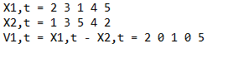
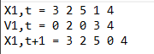
WORKING OF MODIFIED DPSO
POPULATION UPDATION
For implementing the modified DPSO method, the velocity vector is taken as an array of integers ranging from [0 - no.of.tasks] instead of velocity pairs that is used in most of the paper.
These velocity vectors are used to update the population using certain conditions. They are,
SUBTRACTION (position - position)
Let X1,t = [x1,1, x1,2, x1,3, x1,4, x1,5, x1,6, x1,7]
X2,t = [x2,1, x2,2, x2,3, x2,4, x2,5, x2,6, x2,7]
V1,t =X1,t - X2,t
In this case, if x1 and x2 in the jth position are equal, then v1= 0. Otherwise, v1=x1. For example,
ADDITION (position + velocity)
If the jth element of velocity (vj) is equal to 0, the jth position value (xj,t) is inserted into the jth element of the new position (xj,t+1).
In the meantime, if vj is nonzero and does not appear in the new position, then xj,t+1=vj. Otherwise, xj,t+1 is equal to 0. For example,

Slide 27
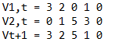
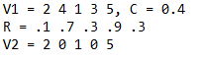
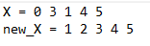
WORKING OF MODIFIED DPSO
POPULATION UPDATION
ADDITION (velocity + velocity)
For new velocity, V=V1 + V2, the jth element of V can be derived as follows,
Vj = v1,j IF v1,j!=0 && v2,j!=0
Vj = v1,j IF v1,j!=0 && v2,j==0
Vj = v2,j OTHERWISE
For example,
MULTIPLICATION (coefficient * velocity)
This operation can be represented as V2= c * V1, where coefficient c is lies in[0, 1] is used to control the effect of V1 that inherit in V2.
For this purpose, a random number, r that lies in [0, 1] is generated. IF r< c, v2=v1, ELSE v2= 0.
For example,
REPAIR FUNCTION
This function is used to repair a sequence which does not follow the precedence relation.
This does multiple swaps and replacements so that the given sequence is in bounds with the precedence relation.
For example,

Slide 28
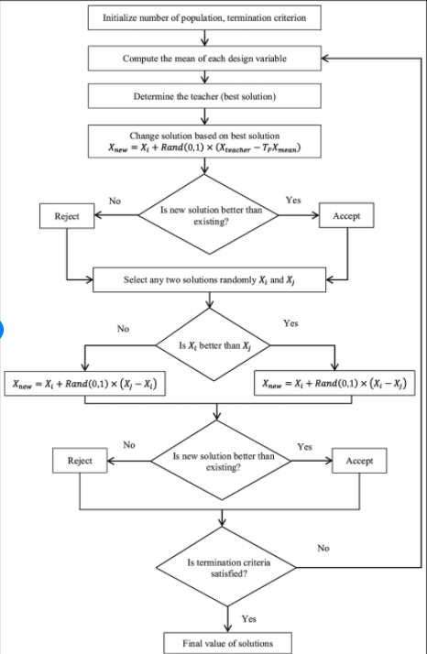
WORKING OF TRADITIONAL TLBO

Slide 29
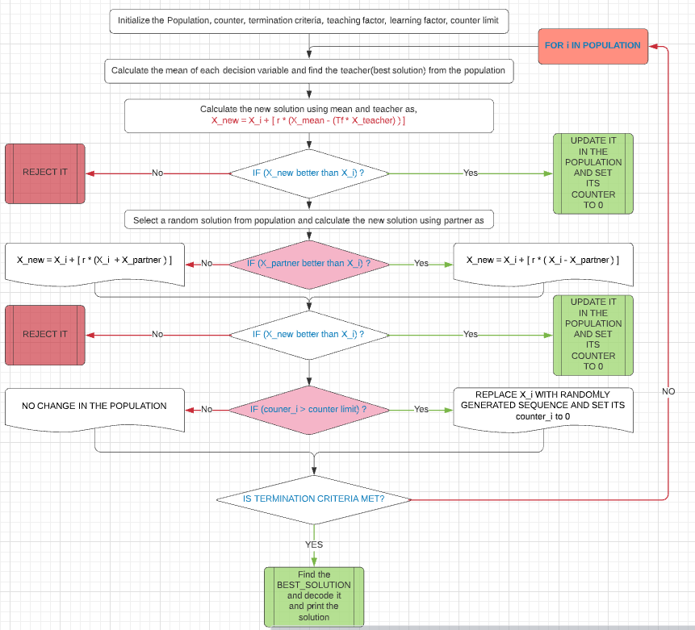
WORKING OF HYBRID TLBO
NOTATIONS USED:
X_i = a single i’th solution in the population.
r = Coefficient that indicates the impact of the mean of the population and the teacher
Tf = Teaching coefficient that indicates the impact of teacher
X_new = newly generated solution for the ith solution in the population
X_mean = mean of the population
X_best = teacher (best solution in the population)
X_partner = mean of the population

Slide 30
WORKING OF HYBRID TLBO
CALCULATING THE MEAN OF THE POPULATION
As mentioned in the previous slide, in teacher phase calculation of the mean of the population is used in the equation, X_new = X_i + r * [ X_mean - (Tf * X_best) ].
As the traditional way of calculating the mean can’t be used here (discrete optimization problem), a different methodology is utilised here.
The calculation is done as,
First the average of the task numbers in that j’th location in the population is calculated.
If the calculated average is not already present in the mean sequence, then it is pushed in to mean sequence.
If the calculated mean value is already present in the mean sequence, then closest value to the mean in that j’th location of the population is inserted if it is not present in the mean sequence.
Otherwise, a random number is generated within the range of 1 - n (number of tasks) and is inserted in the mean sequence if it is not already present in the mean sequence.

Slide 31
WORKING OF HYBRID TLBO
SUBTRACTION OPERATOR
As mentioned in the previous slide, in teacher phase and learner phase, subtraction of the solutions is done as,
X_new = X_i + r * [ X_mean - (Tf * X_best) ].
As the traditional way of subtraction is not possible here as the variables are discrete, a different methodology is used as,
For each task number in i’th position of the sequences, if both the sequence have same task number, then 0 is inserted in the i’th position of the result.
If they are not same, a random number is generated between 0 and 1 and is compared with the coefficient(Tf / Tp).
If the random number generated is less than the coefficient then, the task number in i’th position from the second sequence is inserted into the i’th position of the result.
Otherwise, 0 is inserted in the i’th position of the result.

Slide 32
WORKING OF HYBRID TLBO
ADDITION OPERATOR
As mentioned in the previous slide, in teacher phase and learner phase, addition of the solutions is done as,
X_new = X_i + r * [ X_mean - (Tf * X_best) ].
As the traditional way of addition is not possible here as the variables are discrete, a different methodology is used as,
For each task number in i’th position of the sequences, if both the sequence have same task number, then task number from in i’th position of first sequence is inserted in the i’th position of the result.
If they are not same, a random number is generated between 0 and 1 and is compared with the coefficient(r).
If the random number generated is less than the coefficient then, the task number in i’th from the second sequence is inserted into the i’th position of the result.
Otherwise, 0 is inserted in the i’th position of the result.

Slide 33
7.RESULTS
7.1. DATA USED
7.2. MODIFIED DPSO vs HYBRID TLBO

Slide 34
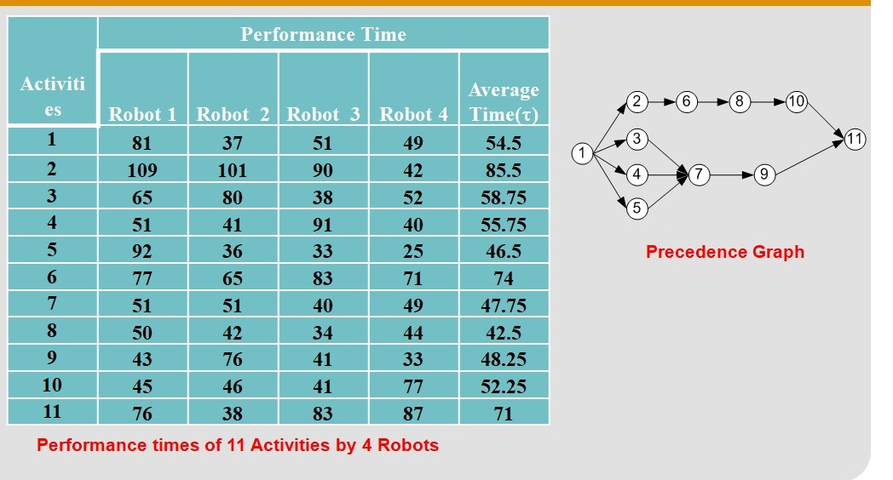
DATA USED
TASK TIME AND PRECEDENCE GRAPH

Slide 35
DATA USED
SETUP TIMES
ACTIVITIES
R
O
B
O
T
18 | 15 | 13 | 18 | 16 | 16 | 10 | 11 | 17 | 14 | 17
10 | 11 | 16 | 16 | 14 | 16 | 10 | 18 | 14 | 13 | 20
19 | 14 | 13 | 18 | 19 | 18 | 20 | 14 | 19 | 17 | 17
11 | 13 | 13 | 15 | 11 | 12 | 11 | 13 | 19 | 12 | 14
This is the input data used that represents the setup times of 4 robots for given 11 different activities.
This setup time is added with the task time for all the robot that performs that particular task. This setup time includes the time for setting up the robot, fixing the tool, etc..,

Slide 36
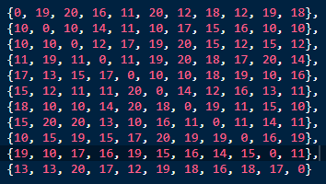
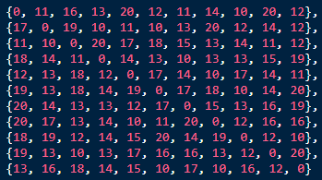
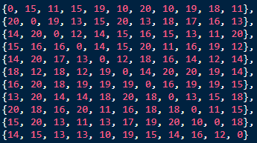
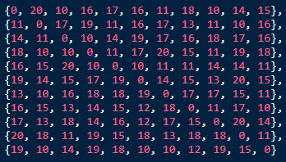
DATA USED
SEQUENCE DEPENDENT TIMES
R
O
B
O
T
1
R
O
B
O
T
2
R
O
B
O
T
3
R
O
B
O
T
4

Slide 37
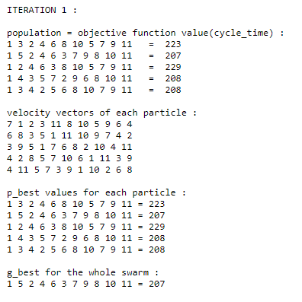
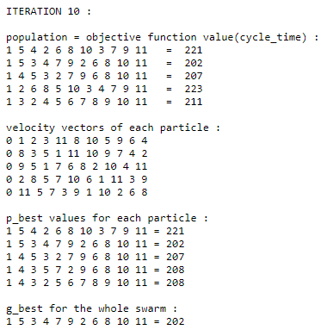
MODIFIED DPSO vs HYBRID TLBO
RESULTS OBTAINED USING MODIFIED DPSO

Slide 38
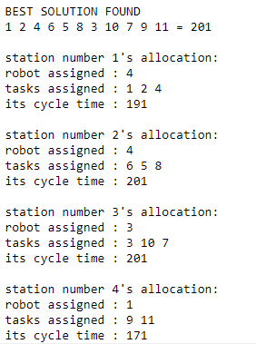
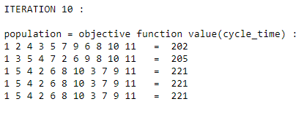
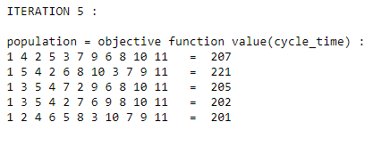
MODIFIED DPSO vs HYBRID TLBO
RESULTS OBTAINED USING HYBRID TLBO

Slide 39
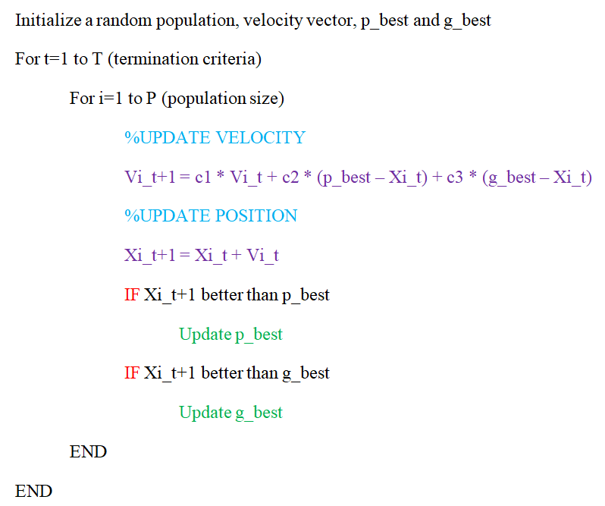
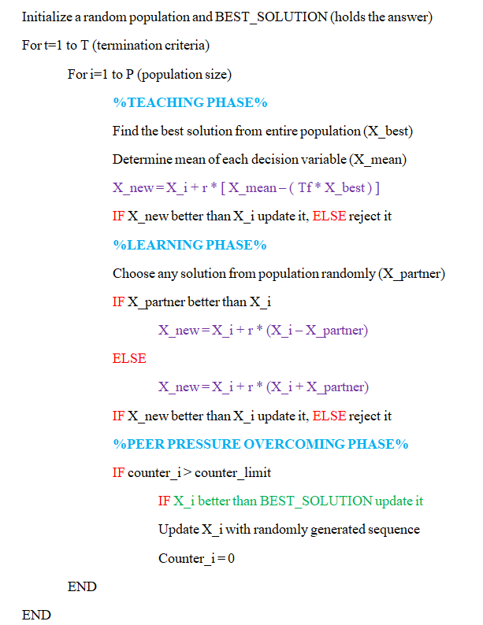
MODIFIED DPSO vs HYBRID TLBO
MODIFIED DPSO vs HYBRID TLBO

Slide 40
MODIFIED DPSO vs HYBRID TLBO
M-DPSO | H-TLBO
1.Modification of traditional Particle Swarm Optimisation to fit into solving discrete optimisation(DO) problems. 2.Number of times objective function evaluated is, Np*T (Np = population size). 3.NO GREEDY selection to update population. 4.Number of parameters that influence the output is, c1, c2, c3. 5.Number of variables in the population updation equation, Velocity, G_best, P_best. 6.Number of special operators used in equations, Addition operator, Subtraction operator, Multiplication operator, Repair function. 7.Best solution obtained is present in the population matrix. 8.Best solution obtained for the example problem, Optimal cycle time = 202. | 1.Modification of traditional TLBO which combines the advantages of scout phase from ABC algorithm and simplicity of TLBO to solve DO problems. 2.Number of times objective function evaluated is, Np*T + Np*T (T = number of iterations). 3.Uses GREEDY selection to update population. 4.Number of parameters that influence the output is, r, Tf/Tp. 5.Number of variables in the population updation equation, X_mean, X_best, X_partner. 6.Number of special operators used in equations, Addition operator, Subtraction operator, Mean calculation, Repair function. 7.Best solution obtained may or may not be present in the population matrix. 8.Best solution obtained for the example problem, Optimal cycle time = 201.

Slide 41
8.GOALS FOR NEXT MEETING
To implement Multi-objective in reducing cost of operations & improving ergonomics, along with cycle-time reduction
To develop the code to suit the user flexibility to fine tune the assembly line parameters as input and get the output data accordingly.
To include both human & robotic data sets and allocation, according to user/referred real world constraints.
Possibly arrive at more new variants in both PSO and TLBO, after inclusion of the above considerations.

Slide 42
9. MILESTONES
& GANTT CHART

Slide 43
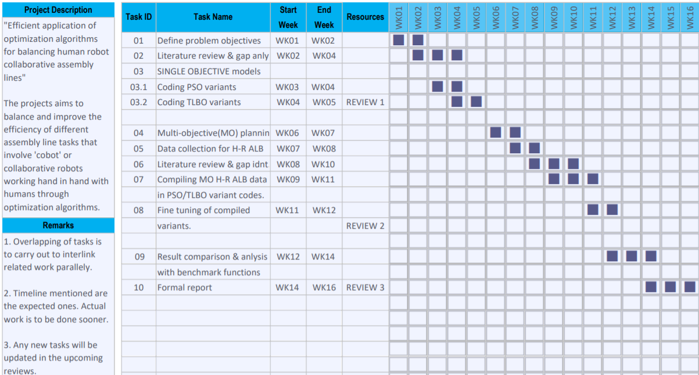

Milestone

Slide 44
10. REFERENCES

Slide 45
Chutima, Parames. (2022). A comprehensive review of robotic assembly line balancing problem. Journal of Intelligent Manufacturing. 33. 10.1007/s10845-020-01641-7.
Christian Weckenborg, Thomas S. Spengler, Assembly Line Balancing with Collaborative Robots under consideration of Ergonomics: a cost-oriented approach, IFAC-PapersOnLine, Volume 52, Issue 13, 2019,
Pages 1860-1865, ISSN 2405-8963, https://doi.org/10.1016/j.ifacol.2019.11.473.
Weckenborg, C., Kieckhäfer, K., Müller, C. et al. Balancing of assembly lines with collaborative robots. Bus Res 13, 93–132 (2020). https://doi.org/10.1007/s40685-019-0101-y
Nils Boysen, Philipp Schulze, Armin Scholl, Assembly line balancing: What happened in the last fifteen years?, European Journal of Operational Research, 2021, ISSN 0377-2217, https://doi.org/10.1016/j.ejor.2021.11.043.
Tamás Koltai, Imre Dimény, Viola Gallina, Alexander Gaal, Chiara Sepe, An analysis of task assignment and cycle times when robots are added to human-operated assembly lines, using mathematical programming models, International Journal of Production Economics, Volume 242, 2021, 108292, ISSN 0925-5273, https://doi.org/10.1016/j.ijpe.2021.108292.
Nicole Berx, Wilm Decré, Ido Morag, Peter Chemweno, Liliane Pintelon, Identification and classification of risk factors for human-robot collaboration from a system-wide perspective, Computers & Industrial Engineering, Volume 163, 2022, 107827, ISSN 0360-8352, https://doi.org/10.1016/j.cie.2021.107827.

Slide 46
Ying Sun, Yuelin Gao. (2019). A Multi-Objective Particle Swarm Optimization Algorithm Based on Gaussian Mutation and an Improved Learning Strategy. doi:10.3390/math7020148
Mohd Fadzil Faisae Ab Rashid, Windo Hutabarat, Ashutosh Tiwari. (2016). Multi-objective discrete particle swarm optimisation algorithm for integrated assembly sequence planning and assembly line balancing. DOI: 10.1177/0954405416673095
Parsopoulos, Konstantinos & Vrahatis, Michael. (2008). Multi-objective particle swarm optimization approaches. 10.13140/2.1.5189.4721.
Kashani, A.R., Chiong, R., Mirjalili, S. et al. Particle Swarm Optimization Variants for Solving Geotechnical Problems: Review and Comparative Analysis. Arch Computat Methods Eng 28, 1871–1927 (2021). https://doi.org/10.1007/s11831-020-09442-0
Y. Ma, X. Zhang, J. Song et al., A modified teaching-learning-based optimization algorithm for solving optimization problem, Knowledge-Based Systems (2020), doi: https://doi.org/10.1016/j.knosys.2020.106599.
Ahmad Taheri, Keyvan RahimiZadeh, Ravipudi Venkata Rao. An efficient Balanced Teaching-Learning-Based optimization algorithm with Individual restarting strategy for solving global optimization problems, Information Sciences, Volume 576, 2021, Pages 68-104, ISSN 0020-0255, https://doi.org/10.1016/j.ins.2021.06.064.

Slide 47
Hamzadayi, A. (2018). Balancing of mixed-model two-sided assembly lines using teaching-learning based optimization algorithm. Pamukkale University Journal of Engineering Sciences, 24, 682-691.
Li, Da & Zhang, Chaoyong & Shao, Xin & Xie, Zhan. (2014). An Improved TLBO Algorithm for Balancing Stochastic Two-Sided Assembly Line. Applied Mechanics and Materials. 610. 345-349. 10.4028/www.scientific.net/AMM.610.345.
Qiuhua Tang, Zixiang Li, LiPing Zhang, and Chaoyong Zhang. 2017. Balancing stochastic two-sided assembly line with multiple constraints using hybrid teaching-learning-based optimization algorithm. Comput. Oper. Res. 82, C (June 2017), 102–113. DOI:https://doi.org/10.1016/j.cor.2017.01.015

